Slide 1
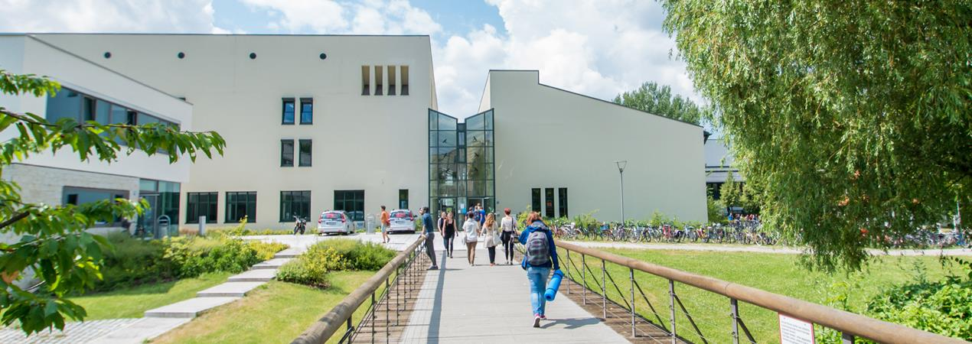
Seminar Kick-Off Meeting
Dr. Nikolaos Athanasios Anagnostopoulos

Slide 2
General Information
Goal: Writing a scientific paper
Grade: Paper (70%) + Reviews (10%) + Presentation (20%)
Credits: 5 ECTS
Tool: LaTeX, OpenConf
You are not allowed to use ChatGPT or anything else to automatically generate text.
Work steps:
  Topic selection and registration
  Discussion with assigned supervisor
  Writing the paper
  Paper submission stub and registration as reviewer – deadlines apply
  First version submission (blind) – deadline 04.01.2027
  Review phase – deadline 18.01.2027
  Final version submission (non-blind) – deadline 01.02.2027
  Final presentation (offline) – 15.02.2027

Slide 3
Registration
Topic assignment
Registration in person
Fill in this form, sign it and send it back
After registration you can not be unregistered!
If you are not able to finish the course after registration, you will get 5,0.
You are not allowed to use ChatGPT or anything else to automatically generate text.

Slide 4
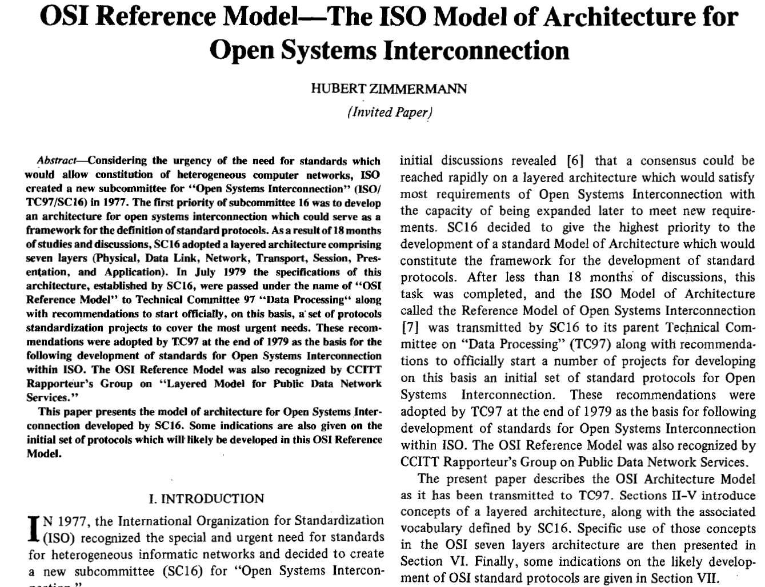
Paper Requirements
LaTex, Overleaf
IEEE double-column conference template (https://www.ieee.org/conferences/publishing/templates.html)
6 pages, with the 6th page having adequate content

Slide 5
Paper Structure
Title at the top, plus author’s name and affiliation (name and affiliation need to be hidden for the first version submission!)
Abstract: short summary of your work, with emphasis on the most important points – keywords after the abstract
Introduction of the topic, which motivates the reader to read further and lets the reader know why the topic is important… (may also contain a list of contributions or an overview of how the (rest of the) paper is organized)
Related Work: overview of papers similar to your future paper (e.g. if you are writing a review paper, you should include in this section a description of other reviews, surveys and overviews regarding similar topics, but not of normal papers)
Implementation (in the case of the seminar, State of the Art / Overview of the Topic) – Here, for the seminar, you provide a description of your topic based on the relevant literature that you have found. In general, you would describe your experiment, the implementation, etc. (own contribution section)
Discussion/Evaluation (normally, an assessment of results) – For the seminar, it is your own assessment of the literature from point 5. In general, it would be an assessment of the results produced by point 5. (own contribution section)
Conclusion: short summary/overview of your work, stress the most important results, what your work has achieved
References: list of works cited, after the Conclusion (use the IEEE bibtex template!!)

Slide 6
General Paper Tips
Sections may be renamed and/or split according to content
  The “Introduction” could be named “Introduction and Motivation” and/or have a “Motivation” subsection
  Apart from “Related Work”, you may need a section on “Background Information”, or have a section titled “Related Work and Background Information”, with relevant subsections
  The “Conclusion” may also consider proposals for future work and could be titled “Conclusion and Future Work”
  Pay special attention on the sections regarding the Implementation, Discussion/Evaluation or any other which contains your own contribution!
Submit an anonymous document (PDF) to be reviewed (first submission), and then, after addressing the relevant comments, submit a document that contains your name and affiliation (final and last submission)

Slide 7
Paper Tips
Keep notes from what you are reading. Focus on extracting the most important information. Compare the abstracts. Try to scan through papers for their results, read the contribution sections.
Latex: https://ctan.mc1.root.project-creative.net/macros/latex/contrib/IEEEtran/IEEEtran_HOWTO.pdf
Use Overleaf: https://www.overleaf.com
Academic language tips: https://www.scribbr.com/academic-writing/taboo-words/
Lengthy guides to get some ideas:
https://www.elsevier.com/connect/11-steps-to-structuring-a-science-paper-editors-will-take-seriously
https://www.nature.com/articles/d41586-018-02404-4
https://www.washingtonpost.com/blogs/answer-sheet/post/a-guide-to-writing-an-academic-paper/2012/01/18/gIQAjGCTCQ_blog.html
https://www.tandfonline.com/doi/abs/10.1080/10511253.2012.730617
https://www.tandfonline.com/doi/abs/10.1080/01441647.2015.1065456
https://www.ncbi.nlm.nih.gov/pmc/articles/PMC3178846
https://www.sciencedirect.com/science/article/pii/S1443950600900817
http://www.gpmems.com/_media/wztg/how_to_write_a_paper.pdf
https://www.karger.com/Article/Abstract/79266
https://www.tandfonline.com/doi/abs/10.1179/146531204225011328
Bottomline: Everyone writes quite differently… Do not follow a precise style dictated here or there. Rather write in your own style: what you will be talking about (Introduction), what has already been done (Related Work), what you did and how you did it (Implementation, Materials and Methods), what you observed and what you think about it (Results, Discussion, Evaluation, Comparison), as well as what is the bottomline conclusion from your work (Conclusion).

Slide 8
Paper Tips
Your work needs to make sense and have a clear flow, a clear connection between sentences, paragraphs, and sections. What you write needs to be sound and valid. The sentences need to fit semantically with each other. Keep information found in different sections consistent.
NO PLAGIARISM! If the information conveyed is not based on your own knowledge and/or common sense, then, its source needs to be cited and the relevant reference needs to be provided. E.g., “The sun rises every day.” probably needs no citation, while “HR 5171 A is a fireball 1,300 times larger than the Earth’s Sun.” probably needs a citation. In case of significant plagiarism you will be graded with 5,0!
Just write… Planning makes sense, but sometimes, it may be better to write some text segments down first and then make them fit with each other. Avoid trying to get everything perfect at your first try. Try to write without interruptions, so that what you write is consistent. It’s almost always better to write something (as long as it does make some sense), rather than to plan how to write it. Do make a rough plan, but do not spend all your time on making a very good plan. Do not leave everything for the LAST MOMENT!
Do read what you have written. You will not only fix mistakes, but you will also be able to see if different text segments fit with each other.
Avoid translating single words from other languages to English. Try translating a full sentence or text segment, and then phrased in more than one way. Look up if your translation, e.g., “Unified Provinces of America”, is used online often.
For “real” works, you will most often be accepted or rejected based on the novelty, rather than on the actual merits of your writing. Tough luck: In the seminar, the novelty is extremely low, you are mostly recycling other people’s work, and need to find an interesting way of evaluating it.

Slide 9
Step-by-Step
Submit your first paper version without your name and affiliation! ANONYMOUS!
Register as a Reviewer
Finish reviews of assigned to you papers
Receive reviews for your own paper (in OpenConf)
Revise your work based on the comments received. Do it in coordination with your supervisor, as some comments from the reviewers may be contradictory or pointing you to the wrong direction.
Submit the final version of your paper (PDF), with your name and affiliation (NOT ANONYMOUS).
Present your work in person. Attending all the presentations of your colleagues is mandatory.

Slide 10
Submission Procedure (first time)
For submissions, you will use OpenConf
(https://openconf.hardwaresecurity.eu/openconf.php)
Submission steps:
Click “Make Submission” and fill the form (you will receive by e-mail submission ID). Make sure the e-mail that you provide in the form works and you check it often, because it will be used to contact you.
Return to home page and click “Upload File” (use submission ID from e-mail and password which you set up during 1st step).
You may submit a new version of the PDF file as many times as you want until the deadline; only the last one counts.

Slide 11
Registration as a Reviewer
For reviews, you will use OpenConf
(https://openconf.hardwaresecurity.eu/openconf.php)
Submission steps:
Click “Review Cmt. Sign Up” (it will be available after first submission deadline). Fill in the provided form. Make sure the e-mail that you provide in the form works and you check it often, because it will be used to contact you.
Return to home page and click “Review Cmt. Sign In” (use reviewer ID and password which you set up during 1st step).
You will see works of your colleagues assigned to you for review. Clicking on the submission title will bring up the online review form and clicking on the file symbol to the right of the submission title will bring up a copy of the file. You may reopen and modify or amend previously submitted reviews.

Slide 12
Review Procedure – Main Structure
Express the main idea(s) of the manuscript in two sentences, in order to demonstrate that you have understood what is written about.
State how well the authors have managed to present these ideas and your opinion regarding the work as it currently is.
Finally, propose potential improvements that you have identified that may be needed.
All your comments should be addressed to the authors and placed in the relevant text box field. Only technical comments, such as potential plagiarism, the manuscript being overlength, or the identity of the author being evident, should be repeated on the relevant text box field for comments to the program committee.

Slide 13
Review Tips
Simple and easy to understand
For those who may want to follow a more elaborate approach (which is NOT required), two short online courses are available, both of which lead to a "certification paper":
  by Elsevier at https://researcheracademy.elsevier.com/navigating-peer-review/certified-peer-reviewer-course
  by Springer-Nature at https://masterclasses.nature.com/online-course-on-peer-review/16507836
If you want to include a commented PDF version of the manuscript in your review, please use DropBox (or some similar "semi-private" service) and provide a link in your review, for the author to be able to access this file. Do NOT just upload such a file to some publicly accessible website! By reviewing unpublished submissions, you are accepting the ethical responsibility not to disclose their contents to anyone else.

Slide 14
Submission Procedure (final document)
For submissions, you will use OpenConf
(https://openconf.hardwaresecurity.eu/openconf.php)
Submission steps:
Click “Edit Submission” and use your submission ID and password to log in. Then, you can edit the information of your submission, as needed, e.g., revise the abstract.
Return to home page and click “Upload File” and use your submission ID and password to log in and upload your revised work that takes into account the comments of the reviewers.
You may submit a new version of the PDF file as many times as you want until the deadline; only the last one counts.

Slide 15
Presentation
15 min - presentation
5 min – questions
10-15 slides (not 50!)
Focus on the main idea of your manuscript
Do not describe in detail not important things
Avoid to use a lot of text on the slides (people can process only 7 bullet points on one slide)
Do not read from the slides
Follow a meaningful and well-structured flow
Practice your presentation

Slide 16
Bonus Practical Work
In coordination with your supervisor, you can work on a practical implementation relevant to your topic for a bonus on your grade
This bonus can range up to +1,0 added to your final grade, and should be agreed upon by you and your supervisor before you proceed further.
Nevertheless, such practical work should not hinder you from working on the normal tasks of the seminar, as one of the seminar’s main goals is to help you learn how to write a scientific manuscript.

Slide 17

Thank you for your attention!!!
https://www.colourbox.de/bild/fragen-frage-information-bild-50529935

